Slide 1
Chapter 2: Atomic Structure & Interatomic Bonding
ISSUES TO ADDRESS...
• What promotes bonding?
• What types of bonds are there?
• What properties are inferred from bonding?

Slide 2
Atomic Structure
atom – electrons – 9.11 x 10⁻³¹ kg
protons
neutrons
atomic number = # of protons in nucleus of atom
= # of electrons of neutral species
A [=] atomic mass unit = amu = 1/12 mass of ¹²C
Atomic wt = wt of 6.022 x 10²³ molecules or atoms
1 amu/atom = 1g/mol
C 12.011
H 1.008 etc.
} 1.67 x 10⁻²⁷ kg

Slide 3
AVAGADRO’S NUMBER = 6.022 x 10²³ = N_{A}
ATOMIC OR MOLECULAR WEIGHT =
N_{A} x WEIGHT PER ATOM.
number of neutrons = N
number of protons = Z
A= Z + N

Slide 4
Atomic Structure
Valence electrons determine all of the following properties
    Chemical
    Electrical
    Thermal
    Optical

Slide 5
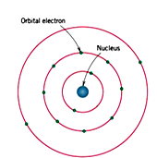
BOHR ATOM

Slide 6
Electronic Structure
Electrons have wavelike and particulate properties.
  This means that electrons are in orbitals defined by a probability.
  Each orbital at discrete energy level is determined by quantum numbers.
  Quantum # Designation
  n = principal (energy level-shell) K, L, M, N, O (1, 2, 3, etc.)
  l = subsidiary (orbitals) s, p, d, f (0, 1, 2, 3,…, n -1)
  m_{l} = magnetic 1, 3, 5, 7 (-l to +l)
  m_{s} = spin ½, -½

Slide 7
Electron Energy States
Electrons...
• have discrete energy states
• tend to occupy lowest available energy state.
4d
4p
N-shell n = 4
3d
4s
Energy
3p
M-shell n = 3
3s
Adapted from Fig. 2.4, Callister & Rethwisch 8e.
2p
L-shell n = 2
2s
1s
K-shell n = 1

Slide 8
Survey of Elements
• Most elements: Electron configuration not stable.
Element
Atomic #
Electron configuration
Hydrogen
1
1s
1
Helium
2
1s
2
(stable)
Lithium
3
1s
2
2s
1
• Why? Valence (outer) shell usually not filled completely.
Beryllium
4
1s
2
2s
2
Boron
5
1s
2
2s
2
2p
1
Carbon
6
1s
2
2s
2
2p
2
...
...
Neon
10
1s
2
2s
2
2p
6
(stable)
Sodium
11
1s
2
2s
2
2p
6
3s
1
Magnesium
12
1s
2
2s
2
2p
6
3s
2
Aluminum
13
1s
2
2s
2
2p
6
3s
2
3p
1
...
...
Argon
18
1s
2
2s
2
2p
6
3s
2
3p
6
(stable)
...
...
...
Krypton
36
1s
2
2s
2
2p
6
3s
2
3p
6
3d
10
4s
2
4p
6
(stable)

Slide 9
Electron Configurations
Valence electrons – those in unfilled shells
Filled shells more stable
Valence electrons are most available for bonding and tend to control the chemical properties
  example: C (atomic number = 6)
    1s² 2s² 2p²
valence electrons

Slide 10
Electronic Configurations
26
1s² 2s² 2p⁶ 3s² 3p⁶
3d ⁶ 4s²
Fe - atomic # =
4d
4p
N-shell n = 4
valence
electrons
3d
4s
Energy
3p
M-shell n = 3
3s
2p
L-shell n = 2
2s
1s
K-shell n = 1

Slide 11
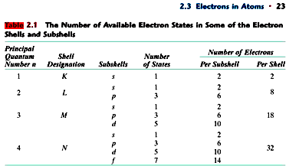
Electrons in different shells

Slide 12
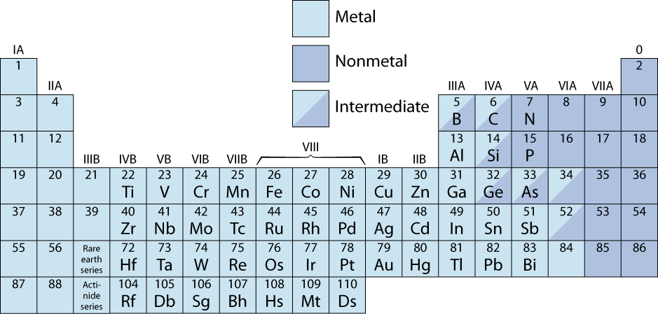
The Periodic Table
give up 1e⁻
• Columns: Similar Valence Structure
inert gases
give up 2e⁻
accept 2e⁻
accept 1e⁻
H
give up 3e⁻
He
Li
Be
O
F
Ne
Na
Mg
S
Cl
Ar
K
Ca
Sc
Se
Br
Kr
Rb
Sr
Y
Te
I
Xe
Cs
Ba
Po
At
Rn
Fr
Ra
Electropositive elements:
Readily give up electrons
to become + ions.
Electronegative elements:
Readily acquire electrons
to become - ions.

Slide 13
Interatomic Bonding
The forces that hold atoms together are called cohesive forces. These interatomic bonds may be classified as primary or secondary. The strength of these bonds and their ability to form after breakage determine the physical properties of material.
Primary Bond
A bond that forms between atoms and that involves the exchanging or sharing of electrons.
Secondary Bond
A bond that involves attraction between molecules. Unlike primary bonding, there is no transfer or sharing of electrons.

Slide 14
Classification of Interatomic Bonding
Interatomic Bonding
Primary
Secondary
Metalic Bonds
Ionic Bonds
Covalent Bonds
Van der Waals Forces
Hydrogen Bonds

Slide 15
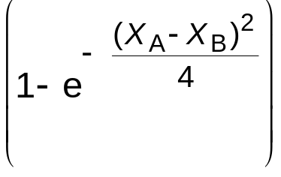
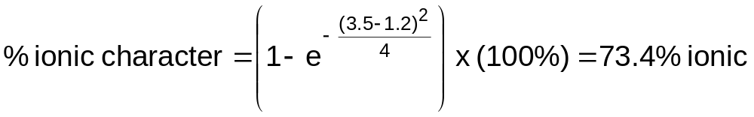
Primary Bonding
Metallic Bond -- delocalized as electron cloud
Ionic-Covalent Mixed Bonding
% ionic character =
where X_{A} & X_{B} are Pauling electronegativities
x
(
100
%)
Ex: MgO X_{Mg} = 1.2
X_{O} = 3.5

Slide 16
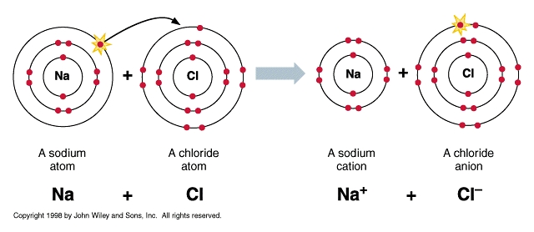
Interatomic Primary Bonding
Interatomic primary bonding may be of three different types:
1. Ionic Bonds:
Result from the mutual attraction of positive and negative charges.
The classic example is sodium chloride (Na⁺Cl⁻).

Slide 17
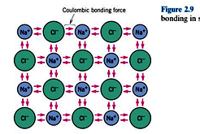



Slide 18
Ionic bond – metal + nonmetal
donates accepts
electrons electrons
Dissimilar electronegativities
ex: MgO Mg 1s² 2s² 2p⁶ 3s² O 1s² 2s² 2p⁴
[Ne] 3s²
Mg²⁺ 1s² 2s² 2p⁶ O²⁻ 1s² 2s² 2p⁶
[Ne] [Ne]

Slide 19
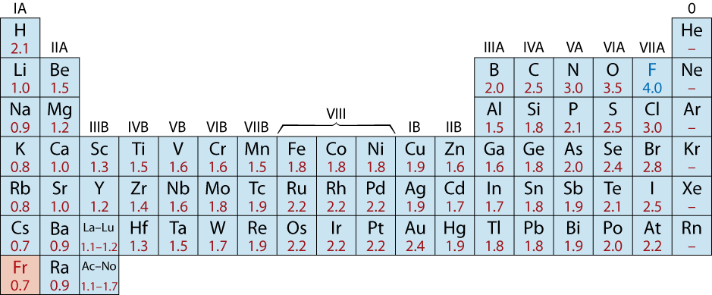
Examples: Ionic Bonding
NaCl
MgO
CaF₂
CsCl
Give up electrons
Acquire electrons
Adapted from Fig. 2.7, Callister & Rethwisch 8e. (Fig. 2.7 is adapted from Linus Pauling, The Nature of the Chemical Bond, 3rd edition, Copyright 1939 and 1940, 3rd edition. Copyright 1960 by Cornell University.

Slide 20
2. Covalent Bonding
Similar electronegativity ∴ share electrons
bonds determined by valence – s & p orbitals dominate bonding
Example: CH₄
shared electrons
C: has 4 valence e⁻,
needs 4 more
H
from carbon atom
CH
4
H: has 1 valence e⁻,
needs 1 more
H
C
H
shared electrons
Electronegativities
are comparable.
from hydrogen
H
atoms

Slide 21
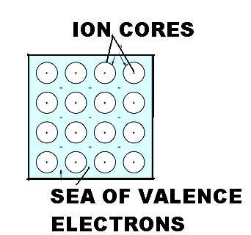
3. Metallic Bonds
It is the attraction force between positive metal ions and the delocalized (freely moving) electrons, gathered in an electron cloud.
These free electrons are responsible for the high electric and thermal conductivities of metals also for their ability to deform plastically.
Found only in metals.

Slide 22
Interatomic secondary Bonding
In contrast with primary bonds, secondary bonds don’t share electrons. Instead, charge variations among molecules or atomic groups induce polar forces that attract the molecules.

Slide 23
Hydrogen Bonding
Bonds between hydrogen atom and atoms of the most electronegative elements (N, O, F) are called hydrogen bonds.
When a water molecule intermingle with other water molecules, the hydrogen (positive) portion of one molecule is attached to the oxygen (negative) portion of its neighboring molecule and hydrogen bridges are formed. Polarity of this nature is important in accounting for the intermolecular reaction in many organic compounds.

Slide 24
Van der Waals Forces
Van der Waals Forces form the basis of a dipole attraction.
Normally, the electrons of the atoms are distributed equally around the nucleus and produce an electrostatic field around the atom. However this field may fluctuate so that its charge becomes momentarily positive and negative. A fluctuating dipole is thus created that will attract other similar dipoles. Such interatomic forces are quite weak .

Slide 25
Secondary Bonding
Arises from interaction between dipoles
• Fluctuating dipoles
asymmetric electron
ex: liquid H₂
clouds
H₂
H₂
+
-
+
-
H
H
H
H
secondary
secondary
bonding
bonding
• Permanent dipoles-molecule induced
-general case:
+
-
secondary
+
-
bonding
-ex: liquid HCl
H
Cl
secondary
H
Cl
bonding
-ex: polymer
secondary bonding
secondary bonding

Slide 26
Summary: Bonding
Type
Bond Energy
Comments
Ionic
Large!
Nondirectional (ceramics)
Covalent
Variable
Directional
(semiconductors, ceramics
polymer chains)
large-Diamond
small-Bismuth
Metallic
Variable
large-Tungsten
Nondirectional (metals)
small-Mercury
Secondary
smallest
Directional
inter-chain (polymer)
inter-molecular

Slide 27
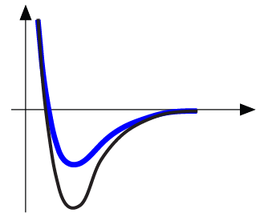
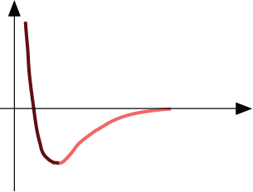
Properties From Bonding: T_{m}
• Bond length, r
• Melting Temperature, T_{m}
Energy
r
• Bond energy, E_{o}
r
o
r
Energy
smaller T_{m}
unstretched length
larger T_{m}
r
o
r
E_{o}
=
T_{m} is larger if E_{o} is larger.
“bond energy”

Slide 28

Properties From Bonding : α
• Coefficient of thermal expansion, α
length,
L
o
Energy
unheated, T
1
Δ
L
unstretched length
r
o
heated, T
2
r
larger α
E_{o}
coeff. thermal expansion
E_{o}
smaller α
Δ
L
=
α
(
T
-
T
)
L
2
1
α is larger if E_{o} is smaller.
o

Slide 29
Summary: Primary Bonds
Ceramics
Large bond energy
large T_{m}
large E
small α
(Ionic & covalent bonding):
Metals
Variable bond energy
moderate T_{m}
moderate E
moderate α
(Metallic bonding):
Polymers
Directional Properties
Secondary bonding dominates
small T_{m}
small E
large α
(Covalent & Secondary):
secondary bonding

